Slide 1
Organisational Behaviour
Topic: Conflict II
Dr.C.Vijaya Banu
Associate Professor, School of Management
SASTRA Deemed University, Thanjavur – 613 401
vijayabanu@mba.sastra.ac.in

Slide 2
Types of Conflict
Task Conflict
Conflicts over content and goals of the work.
Relationship Conflict
Conflict based on interpersonal relationships.
Process Conflict
Conflict over how work gets done.

Slide 3
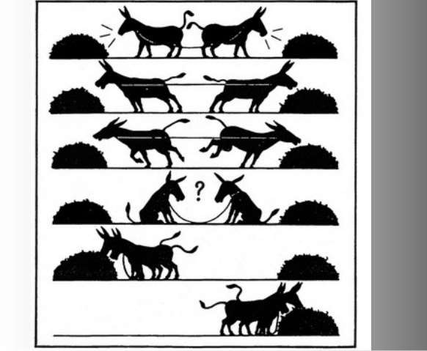
Functional or Constructive Conflict
Functional or Constructive Conflict: works toward the goals of an organization or group
Constructive
Increase information & ideas
Encourages innovative thinking

Slide 4
Dysfunctional/Destructive Conflict
Dysfunctional/Destructive Conflict: blocks an organization or group from reaching its goals
Tension, anxiety, stress
Drives out low conflict tolerant people
Reduce trust
Reduce information

Slide 5
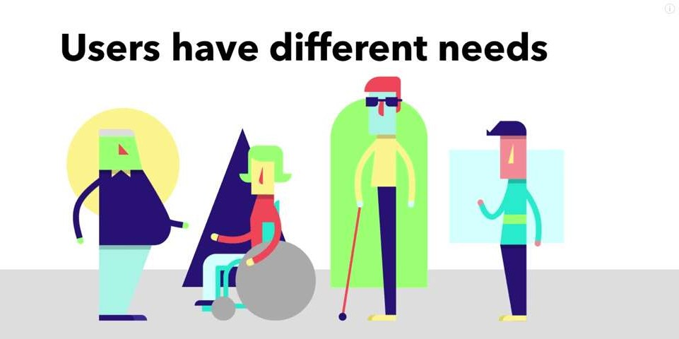
Task Conflict
Task conflict occurs when two parties are unable to move forward on a task due to differing needs, behaviors or attitudes.
It can be conflict over organizational policies and procedures, distribution of resources or the method or means of completing a task.

Slide 6

Relationship conflict
Relationship conflict is a conflict resulting from either personality clashes or negative emotional interactions between two or more people.

Slide 7
Approaches of Conflict
Approach-approach conflict: occurs when you must choose between two desirable outcomes.
Avoidance-avoidance conflict: occurs when you must choose between two unattractive outcomes.
Approach-avoidance: exists when ONE event or goal has both attractive and unattractive features.
Multiple approach-avoidance conflicts: here you must choose between two or more things, each of which has both desirable and undesirable features.

Slide 8
Approach-Approach conflict
In this type of conflict individual will have two desires with positive valence which are equally powerful.
For example, a person has two attractive job offers and he has to choose any one of them- tension arises.
Such conflicts are not so harmful, because after selecting one, the other one automatically subsides or loses its importance to him. But in some situation choice will be very difficult.
Such cases are like ‘you cannot have the cake and eat it too’

Slide 9
Avoidance-Avoidance conflict
This conflict involves two goals with negative valence. At times the individual is forced to choose one among two negative goals.
In such conflicts, both are unwanted goals, but he cannot keep quiet without opting also.
For example, a person must work at a job which he dislikes very much or else he has to remain unemployed.
Here the individual is caught between two repelling threats, fears or situations. When he cannot choose either of them he may try to escape from the field itself. But the consequences of the escape may also be harmful.
For example, a person who cannot convince the mother or the wife may resort to drug consumption which is otherwise dangerous or some people may even commit suicide.

Slide 10
Approach-Avoidance Conflict
This is also a most complex conflict and very difficult to resolve. Because in this type of conflict a person is both attracted and repelled by the same goal object.
Here the goal object will have both positive and negative valences.
The positive valence attracts the person, but as he approaches, the negative valence repels him back.
Attraction of the goal and inability to approach it leads to frustration and tension.
For example, a person is approaching to accept a job offer, because the salary is attractive- but at the same time he is repelled back as the job is very risky.

Slide 11
Multiple Approach - Avoidance Conflicts
Some of the situations in life we come across will involve both positive and negative valences of multiple nature. Suppose a woman is engaged to be married. The marriage to her has positive valences like-providing security to life and marrying a person whom she loves very much.
Suppose, on the other hand, if the marriage is repellent to her because she has to quit her attractive job and salary, recognition which makes her dependent, the situation builds up tension in her.
The resolution of this conflict depends upon the sum total of both valences. If the sum total of attractive valence takes upper hand, she will quit the job and go for marriage; otherwise she may reject marriage and continue the job if the sum total of negative valence is powerful.

Slide 12
Conflict Process
Organizational conflict arises when the goals, interests or values of different individuals or groups are incompatible and those individuals or groups block or thwart one another’s attempts to achieve their objective.
Conflict Process shows how conflict works within the organization.
We can identify the stages that a conflict born and grows in an organization.
In this session, we will look at the stages of a conflict covering the birth, rise, and ending in it.

Slide 13
Process of Conflict
Conflict Process consists of five stages that show how conflict begins, grows, and unfolds among individuals or groups with different goals, interests or values of the organization.
Five Stages of Conflict Process are;
Potential Opposition or Incompatibility.
Cognition and Personalization.
Intentions.
Behavior.
Outcomes.

Slide 14
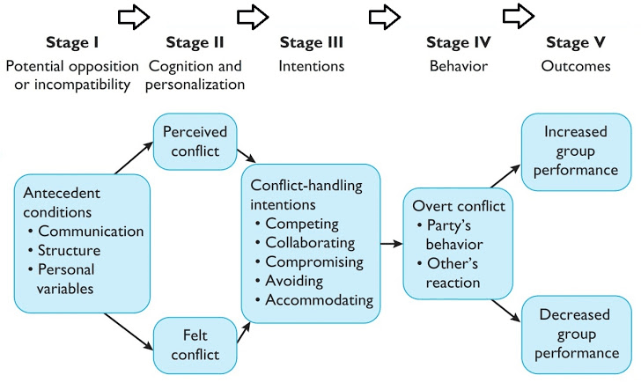
Conflict Process – 5 Stages

Slide 15
5 Conflict-Handling Intention
To put this model into simpler words, the five stages can be regarded as
1) the cause,
2) realizing the conflict
3) the approach to handle the conflict
4) the actual actions taken by conflicting parties
5) the outcome of the conflict resolution

Slide 16
Stage 1
Stage 1: Potential Opposition or Incompatibility
The first step in the conflict process is the presence of conditions that create opportunities for conflict to develop.
These cause or create opportunities for organizational conflict to rise.
They need not lead directly to conflict, but one of these conditions is necessary if the conflict is to surface.
For simplicity’s sake, these conditions have been condensed into three general categories.
Communication,
Structure, and
Personal Variables.

Slide 17
Stage 1
Communications
Different words connotations, jargon insufficient exchange of information and noise in the communication channel are all antecedent conditions to conflict.
Too much communication, as well as too little communication, can lay the foundation for conflict.

Slide 18
Stage 1
Structure
The term structure is used to include variables such as size, the degree of specialization in the tasks assigned to group members, jurisdictional clarity, members / goal compatibility, leadership styles, reward systems and the degree of dependence between groups.
The size and specialization act as forces to stimulate conflict. The larger the group and the more specialized its activities, the greater the likelihood of conflict. Tenure and conflict are inversely related.
The potential for conflicts tends to be greatest when group members are younger and when turnover is high.
In defining where responsibility for action lies; the greater the ambiguity is the greater the potential for conflict to the surface. Such Jurisdictional ambiguity increases inter-group fighting for control or resources and territory

Slide 19
Stage 1
Personal Variables
Certain personality types- for example, individuals who are highly authoritarian and dogmatic- lead to potential conflict. Another reason for the conflict is the difference in value systems.
Value differences are the best explanations of diverse issues such as prejudice disagreements over one’s contribution to the group and rewards one deserves.

Slide 20
Stage 2
Cognition and Personalization
Perceive Conflict: Conflict must be perceived by the parties to it whether or not the conflict exists is a perception issue.
If no one is aware of a conflict, then it is generally agreed that no conflict exists. Because conflict is perceived does not mean that is personalized.
Felt Conflict: The place in the process where the parties decide what the conflict is about and emotions play a major role in shaping perception. (Anxiety, tenseness, stress etc..)
For example; A may be aware that B and A are in serious disagreements but it may not make A tense and it may have no effect whatsoever on A’s affection towards B.
It is the felt level when individuals become emotionally involved that parties experience anxiety, tension or hostility.

Slide 21
Stage 3
Intentions
Intentions are decisions to act in a given way, intentions intervene between people’s perception and emotions and their overt behavior.
Overt Behavior that can be observed by someone other than the person performing it (i.e. singing, screaming, laughing, smoking, eating, etc.).
Using two dimensions
COOPERATIVENESS (the degree to which one party attempts to satisfy the other party’s concerns) and
ASSERTIVENESS (the degree to which one party attempts to satisfy his or her concerns)

Slide 22
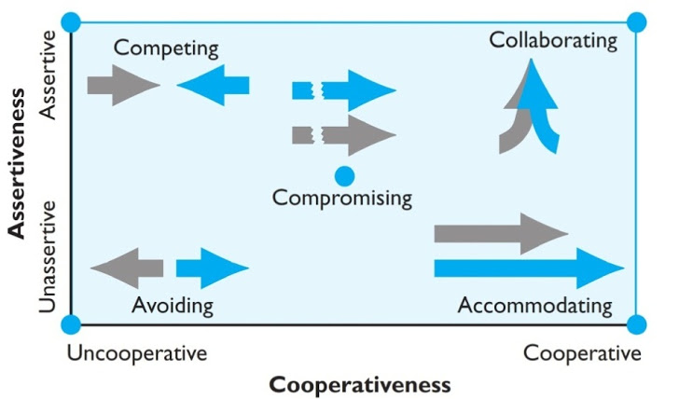
Stage 3
Five conflict-handling intentions can be identified.

Slide 23
5 Conflict-Handling Intention
There are 5 conflict-handling intentions;
Competing (I Win, You Lose),
Collaborating (I Win, You Win),
Avoiding (No Winners, No Losers),
Accommodating (I lose, You win), and
Compromising (You Bend, I Bend).

Slide 24
Conflict- Handling Orientation | Best Scenario to Use Conflict- Handling Orientation
Competition | When quick, decisive action is vital. On important issues where unpopular actions need implementing. On issues vital to the organization’s welfare and when you know you’re right Against people who take advantage of non¬competitive behavior.
Collaboration | To find an integrative solution when both sets of concerns are too important to be compromised. When your objective is to learn. To merge insights from people with different perspectives To gain commitment by incorporating concerns into a consensus. To work through feelings that have interfered with a relationship.
Avoidance | When an issue is trivial, or more important issues are pressing. When you perceive no chance of satisfying your concerns. When potential disruption outweighs the benefits of resolution. To let people cool down and regain perspective. When gathering information supersedes immediate decision. When others can resolve the conflict more effectively. When issues seem tangible or symptomatic of their issues.
Accommodation | When you find you are wrong to allow a better position to be heard to learn and to show your reasonableness. When issues are more important to others than yourself to satisfy others and maintain cooperation. To build social credit for later issues. To minimize loss when you are outmatched and losing. To allow subordinates to develop by learning from mistakes.
Compromise | When goals are important, but not worth the effort or potential disruption of more assertive modes. When opponents with equal power are committed to mutually exclusive goals. To achieve a temporary settlement to complex issues. To arrive at expedient solutions under time pressure. As a back-up when collaboration or competition is unsuccessful.

Slide 25
Competition | When quick, decisive action is vital. On important issues where unpopular actions need implementing. On issues vital to the organization’s welfare and when you know you’re right Against people who take advantage of non¬competitive behavior.
Collaboration | To find an integrative solution when both sets of concerns are too important to be compromised. When your objective is to learn. To merge insights from people with different perspectives To gain commitment by incorporating concerns into a consensus. To work through feelings that have interfered with a relationship.

Slide 26
Avoidance | When an issue is trivial, or more important issues are pressing. When you perceive no chance of satisfying your concerns. When potential disruption outweighs the benefits of resolution. To let people cool down and regain perspective. When gathering information supersedes immediate decision. When others can resolve the conflict more effectively. When issues seem tangible or symptomatic of their issues.
Accommodation | When you find you are wrong to allow a better position to be heard to learn and to show your reasonableness. When issues are more important to others than yourself to satisfy others and maintain cooperation. To build social credit for later issues. To minimize loss when you are outmatched and losing. To allow subordinates to develop by learning from mistakes.

Slide 27
Compromise | When goals are important, but not worth the effort or potential disruption of more assertive modes. When opponents with equal power are committed to mutually exclusive goals. To achieve a temporary settlement to complex issues. To arrive at expedient solutions under time pressure. As a back-up when collaboration or competition is unsuccessful.

Slide 28
Stage 4
Behavior
Stage where conflict becomes visible.
The behavior stage includes the statements, actions, and reactions made by the conflicting parties.
These conflict behaviors are usually overt attempts to implement each party’s intentions.
But these behaviors have a stimulus quality that is separate from intentions.
As a result of miscalculations or unskilled enactments, overt behaviors sometimes deviate from original intentions.
It helps to think of stage 4 as a dynamic process of interaction.

Slide 29
Stage 5
The action-reaction interplay between the conflicting parties results in consequences.
These outcomes may be functional in that the conflict results in an improvement in the group’s performance, or dysfunctional in that it hinders group performance.
Conflict is constructive
when it improves the quality of decisions that stimulates creativity and innovations
encourage interest and curiosity among group members to provide the medium through which problems can be aired and tensions released and foster an environment of self-evaluation and change.
Conflict is dysfunctional
when uncontrolled opposition breeds discontent, which acts to dissolve common ties and eventually leads to the destruction of the group.
Among the more undesirable consequences are a retarding of communication, reductions in group cohesiveness and subordination of group goals to the primacy of infighting between members.

